Slide 1
WELCOME TO YOUR PRESENTATION

Slide 2
Capstone Project proposal presentation
PRESENTED BY :
SUPERVISED BY :
NAME | ID | INTAKE | SECTION | DEPT.
Maruf Ahmed | 15163103049 | 33 | 02 | CSE
Ashik-E-Rabbi- Md. Toha | 17182103143 | 38 | 04 | CSE
Nafiz Ar Rafi | 17182103359 | 38 | 02 | CSE
Shohana Iasmin | 17182103322 | 38 | 02 | CSE

Slide 3
Project Topic
Automatic Number Plate recognition System
(ANPR)

Slide 4
Table of Content
Abstract
Purpose of Number Plate Detection
Working Procedure On the System
Research Challenge
Existing Work
Proposed Method
Tools Requirements
Future Scope
Conclusion
References

Slide 5
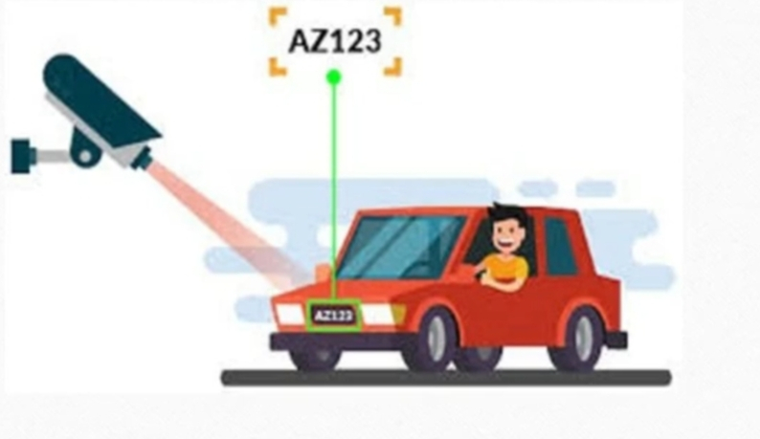
Abstract
Recognition of license by using MATLAB programing
Developing a system for detecting number
For helping or reduce different violation

Slide 6
Purpose of Number Plate Detection
For detecting invalid license cars
Identification of stolen cars
For reduce road accident
For avoiding traffic rules and red Light violations
Preventing illegal activities and smuggling

Slide 7
Working procedure of the system
Step1
Step2
Step3
Step4
Step5
Step6
Capture image
Pre-processing
Plate region extraction
Segmentation of Character in the extracted number plate
Character recognition
Indicate result

Slide 8
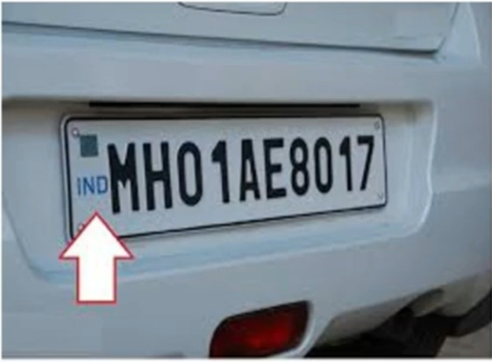
Capture image
The first step is the capture of an image using electronic device such as camera , CCTV camera and webcam etc. can be used to capture the acquired image. Pre-captured image also will be taken. After that we might be proceed in using the MATLAB function to convert the vehicle jpeg or other format image into gray scale format input of this system. The image capture by a camera placed at a distance of 1-2 meters away from the vehicle

Slide 9
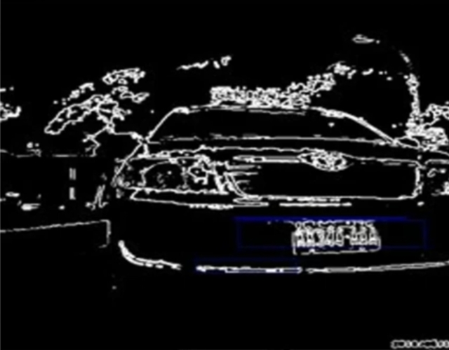
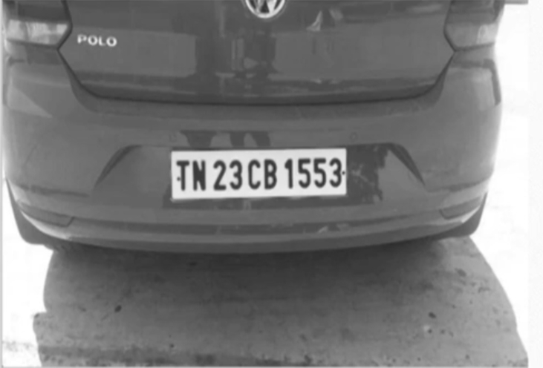
Pre-processing
Gray processing
Median filtering

Slide 10
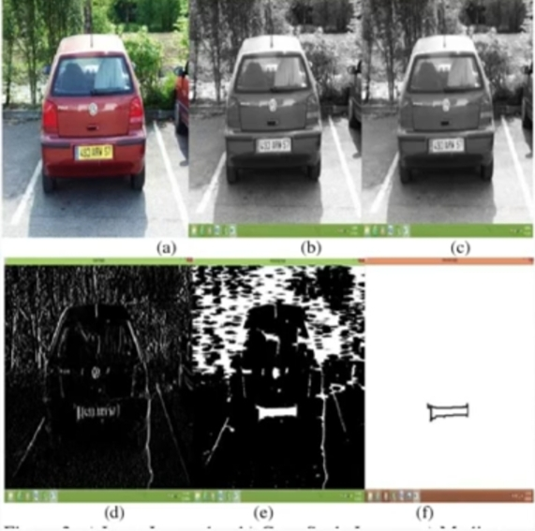
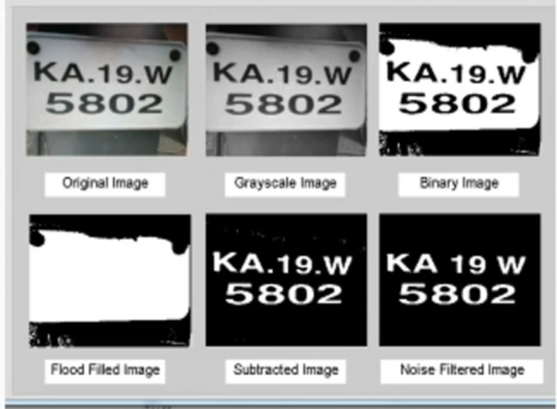
Plate Region Extract

Slide 11
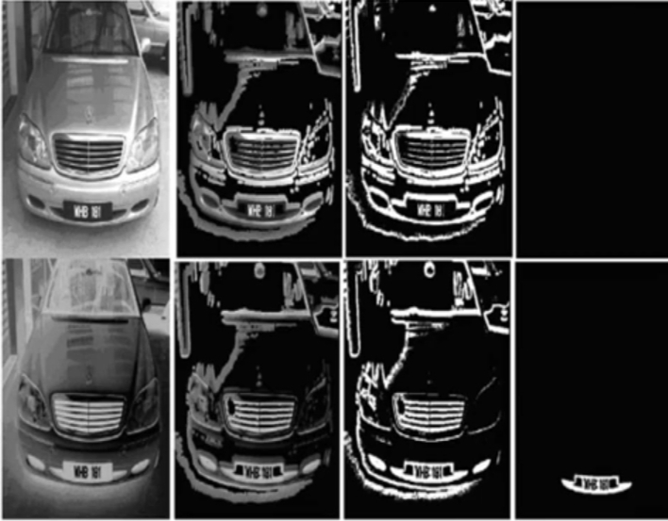
Segmentation of character in the extracted number plater
Start
Localization
Character and number segmentation
Feature Extraction of segmented image
Recognize the extracted feature
Show the license plate
End
License plate segmentation with black background
Character segmentation for extraction of number plate

Slide 12
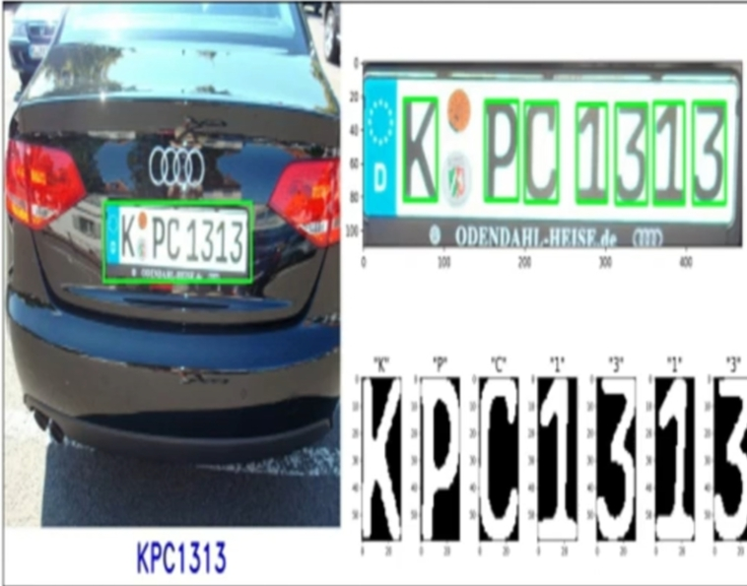
Character Recognition
Row image
Pre-processing
Segmentation
Feature Extraction
Classification
Text
Post-processing

Slide 13
Research Challenges
Collecting data
Method implementation
Implement codding
Learning image processing
Testing the Image processing in Mat Lab
Analysis the better outcomes
Publication the research work

Slide 14


